Slide 1


Lesson 13
The Class P
Theory of Computation
王轩
Wang Xuan

Slide 2
Polynomial time
Polynomial difference between the time complexity of problems measured on deterministic single-tape and multitape TMs.
Exponential difference between the time complexity of problems measured on deterministic and nondeterministic TMs.
All reasonable deterministic computational models are polynomially equivalent.

Slide 3
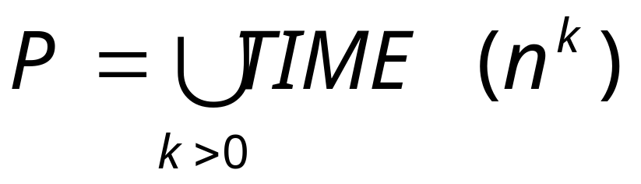
Class P
P is the class of languages that are decidable in polynomial time on a deterministic single-tape Turing machine. In other words,
P is invariant for all models of computation that are polynomially equivalent to the deterministic single-tape Turing machine.
P roughly corresponds to the class of problems that are realistically solvable on a computer.

Slide 4

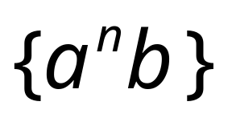
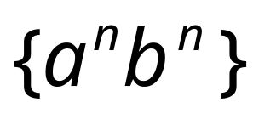

Class
CYK-algorithm
Matrix multiplication

Slide 5
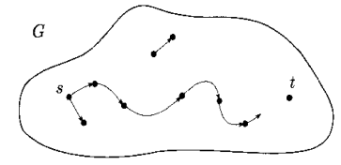
PATH ∈P
PATH={<G,s,t>|G is a directed graph that has a directed path from s to t}.

Slide 6
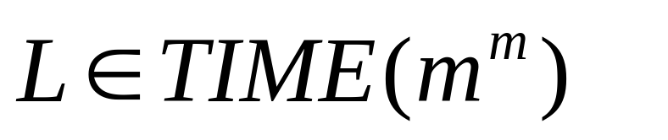
A solution: search exhaustively all paths
L = {<G,s,t>: there is a path in G from s to t}
m is the number of nodes in G.
Exponential time
Intractable problem

Slide 7
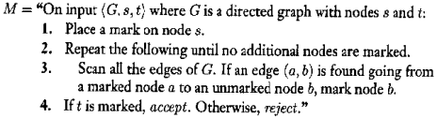
Polynomial time algorithm
A polynomial time algorithm M for PATH operates
The total number of stages is at most 1+1+m, giving a polynomial in the size of G.

Slide 8
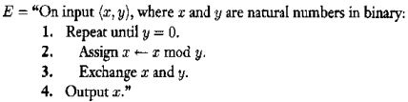
RELPRIME∈P
RELPRIME={<x,y>|x and y are relatively prime}.
  Two numbers are relatively prime if 1 is the largest integer that evenly divides them both.
Proof
  The Euclidean algorithm E is as follows.

Slide 9

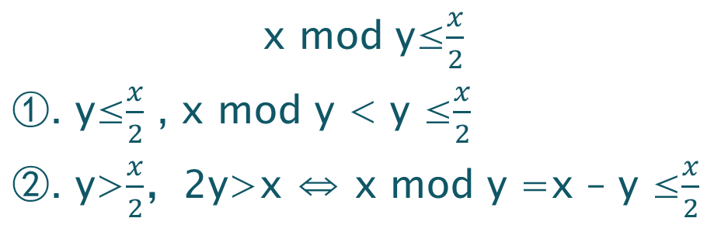
Cont.
Algorithm R solves RELPRIME, using E as a subroutine
For every execution of stage 2 in E, cut the value of x by at least half.
Thus, the maximum number of time that stage 2 and 3 are executed is the lesser of 2log₂x and 2log₂y.
The total running time is polynomial.

Slide 10
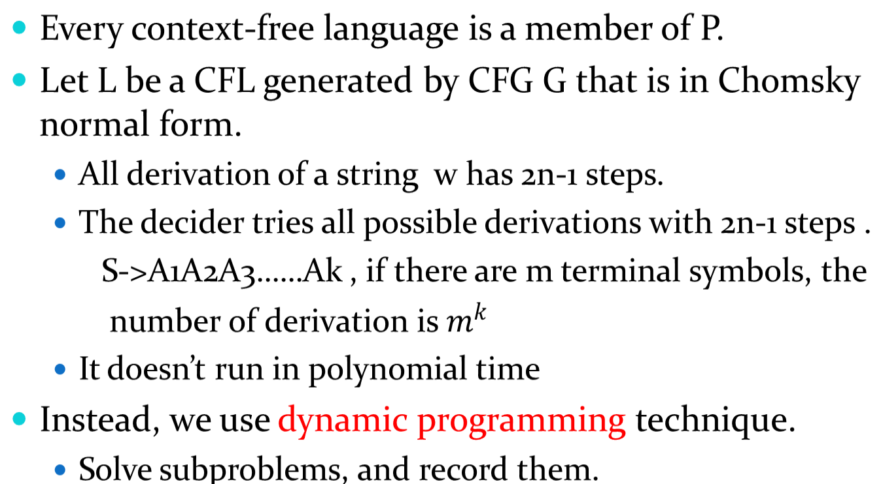
CFL ∈P
Notes:
格式mk！！！

Slide 11
The algorithm enters the solution to this subproblem in an n*n table.
For i≤j the (i,j) entry of the table contains the collection of variables that generate the substring w_{i}w_{i+1}…w_{j}. For i>j the table entries are unused.
i\j

Slide 12
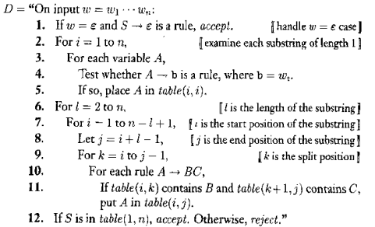
Proof
Let G be a CFG in Chomsky normal form generating the CFL L. Assume that S is the start variable.

Slide 13
Proof
Let G be a CFG in Chomsky normal form generating the CFL L. Assume that S is the start variable.
O(n)
O(n)
O(n)
O(n)
O(n³)
r times(r is the number of rules)

Slide 14
The Class NP
Theory of Computation
王轩
Wang Xuan

Slide 15
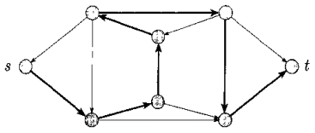
HAMPATH
A Hamiltonian path in a directed graph G is a directed path that goes through each node exactly once.
HAMPATH={<G,s,t>|G is a directed graph with a Hamiltonian path from s to t}.

Slide 16
Verify
We can obtain an exponential time algorithm for the HAMPATH problem.
Don’t know whether HAMPATH is solvable in polynomial time.
But we can check to verify whether the potential path is Hamiltonian in polynomial time.
Verifying the existence of a Hamiltonian path may be easier than determining its existence.

Slide 17

COMPOSITES
A natural number is composite if it is the product of two integers greater than 1. (合数)
COMPOSITES={x|x=pq, for integers p,q>1}
It is a polynomially verifiable problem.
But some are not polynomially verifiable.
  for example

Slide 18
Verifier
A Verifier for a language A is an algorithm V, where
A={w| V accepts <w,c> for some string c}.
A polynomial time verifier runs in polynomial time in the length of w.
A language A is polynomially verifiable if it has a polynomial time verifier.
The information represented by c is called a certificate, or proof, of membership of A. (polynomial length)
  A certificate for the composite number x simply is one of its divisors.

Slide 19
NP
NP is the class of languages that have polynomial time verifiers.
  HAMPATH and COMPOSITES are members of NP.
  COMPOSITES is a member of P which is a subset of NP.
NP comes from nondeterministic polynomial time, and is derived from an alternative characterization by using nondeterministic polynomial time Turing machines.

Slide 20
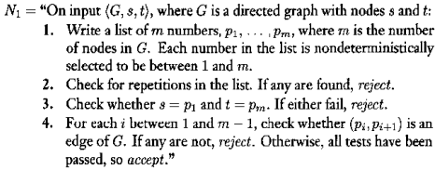
HAMPATH by NTM
A nondeterministic TM decides the HAMPATH problem in nodeterministic polynomial time.

Slide 21
Theorem
A language is in NP iff it is decided by some nondeterministic polynomial time Turing machine.
Idea:
How to convert a polynomial time verifier to an equivalent polynomial time NTM and vice versa.
  NTM simulates the verifier by guessing the certificate.
  The verifier simulates NTM by using the accepting branch as the certificate.

Slide 22
Proof
Let V be the polynomial time verifier for language A in NP. Assume that V is a TM that runs in time n^{k} and construct N as follow.
N=“On input w of length n:
  1. Nondeterministically select string c of length at most n^{k}.
  2. Run V on input <w,c>.
  3. If V accepts, accept; otherwise, reject.”

Slide 23
Proof (2)
Assume that A is decided by a polynomial time NTM N and construct a polynomial time verifier V as follows.
V=“On input <w,c>, where w and c are strings:
  1. Simulate N on input w, treating each symbol of c as a description of the nondeterminstic choice to make at each step.
  2. If this branch of N’s computation accepts, accept; otherwise, reject.”

Slide 24
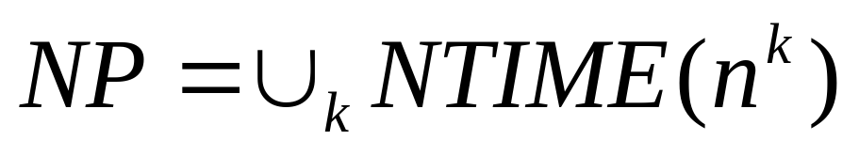
NTIME(t(n))
NTIME(t(n)) ={ L| L is a language decided by an O(t(n)) time nondeterministic Turing machine}.

Slide 25
The clique problem
Clique: a clique in an
undirected graph is
subgraph, wherein every
two nodes are connected
by an edge.
A k-clique is a clique that
containts k nodes.
Does there exist a clique of size 5?

Slide 26
The clique problem
Does there exist a clique of size 5?

Slide 27
CLIQUE is in NP
CLIQUE ={ <G,k>| G is undirected graph with a k-clique}.
Proof:
Construct a polynomial time verifier V for CLIQUE.
V=“ On input <<G,k>, c>:
  1. Test whether c is a set of k nodes in G.
  2. Test whether G contains all edges connecting nodes in C.
  3. If both pass, accept; otherwise, reject.

Slide 28
Alternative proof
Prove using nondeterministic polynomial time Turing machines.
N = “ On input <G,k>, where G is a graph:
  1. Nondeterministically select a subset c of k nodes of G.
  2. Test whether G contains all edges connecting nodes in c.
  3. If yes, accept; otherwise, reject.”

Slide 29
SUBSET-SUM
SUBSET-SUM ={ <S, t> | S={x₁, …, x_{k}} and for some {y₁,…,y_{l}} ⊆{x₁, …, x_{k}} , we have Σy_{i}=t}.
  {x₁, …, x_{k}} and {y₁,…,y_{l}} are multisets and allow repetition of elements.
For example
  <{4,11,16,21,27},25>∈SUBSET-SUM because 4+21=25.

Slide 30
SUBSET-SUM is in NP
Construct a polynomial time verifier V
  V=“On input <<S,t>,c>:
    1. Test whether c is a collection of numbers that sum to t.
    2. Test whether S contains all the numbers in c.
    3. If both pass, accept; otherwise, reject.
Construct a nondeterministically polynomial time TM.
  N=“ On input <S,t>:
    1. Nondeterministically select a subset c of the numbers in S.
    2. Test whether c is a collection of numbers that sum to t.
    3. If the test passes, accept; otherwise, reject.

Slide 31
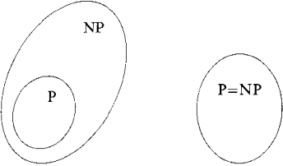
P versus NP
P = the class of languages for which membership can be decided quickly.
NP = the class of languages for which membership can be verified quickly.
P=NP ? Two possibilities.

Slide 32
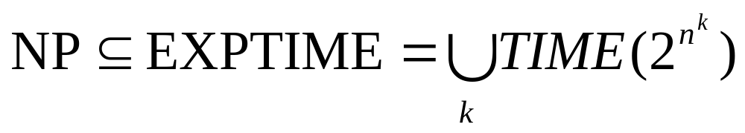
The question of whether P=NP is one of the greatest unsolved problems in theoretical computer science and contemporary mathematics.
The best method known for solving languages in NP deterministically uses exponential time. In other words, we can prove that:
But we don’t know whether NP is contained in a smaller deterministic time complexity class.

Slide 33
NP-Completeness
Theory of Computation
王轩
Wang Xuan

Slide 34
NP-complete
There are certain problems in NP whose complexity is related to that of the entire class.
If a polynomial time algorithm exists for any of these problems, all problems in NP would be polynomial time solvable.
These problems are call NP-complete.

Slide 35
Satisfiability problem
A Boolean formula is an expression involving Boolean variables and operations
  An example: φ=(‾x∨y) ∧(x∨‾z)
  Boolean variables: take on values TRUE and FALSE
  Operations: AND, OR and NOT
A Boolean formula is satisfiable if some assignment of 0s and 1s to variables makes the formula equals 1.
  φ is satisfiable if x=0, y=1, z=0.

Slide 36
Cook-Levin theorem
  The satisfiability problem is to test whether a Boolean formula is satisfiable.
    SAT={< φ >| φ is a satisfiable Boolean formula}.
  Satisfiability problem is a NP-complete problem.
  Cook-Levin theorem: SAT∈P iff P=NP.

Slide 37
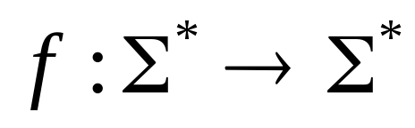



Polynomial Time Reducibility
A function is a
Polynomial time Computable function
if some polynomial time Turing machine
exists that halts with just on its tape,
when started on any input .

Slide 38


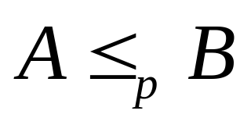

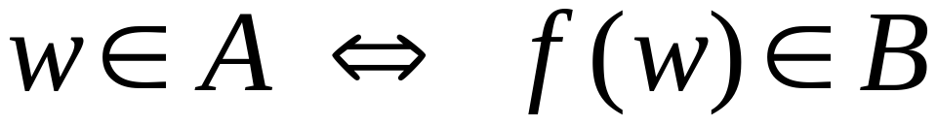
Definition:
Language
is polynomial time reducible to
language , written
if there is a polynomial time computable function such that:
is called the polynomial time reduction of to .

Slide 39
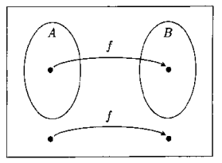
To test w∈A, we use the reduction f to map w to f(w) and test whether f(w) ∈B.

Slide 40
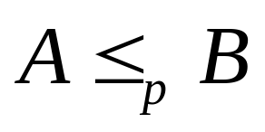




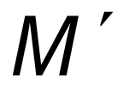

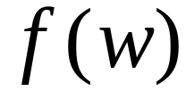

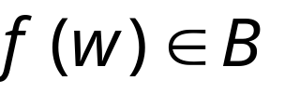

Theorem:
If and , then .
Proof:
Let be the machine that decides
in polynomial time
Machine to decide in polynomial time:
On input string :
1. Compute
2. Run on input
3. If acccept

Slide 41


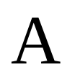
A language is NP-complete if:
is in NP, and
Every language in NP
is polynomial time reduced to

Slide 42

Observation:
If a NP-complete language
is proven to be in P then:

Slide 43
If B is NP-complete and B≤_{p}C for C in NP, then C is NP-complete
B is NP-complete.
Every language A in NP is polynomial time reducible to B
B is polynomial time reducible to C.
Then, every language A in NP is polynomial time reducible to C.

